Slide 1
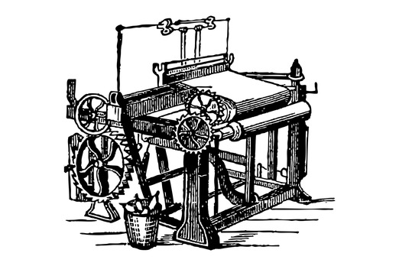
Industrial Predictive Maintenance Using
Physics-Based Analytics and Machine Learning
Author: Muzamil Tariq
Role: Data Scientist

Slide 2

Problem Statement
• Unplanned machine failures cause high downtime and maintenance costs
• Traditional maintenance is either reactive or time-based
• These methods are inefficient and costly
• There is a need for data-driven failure prediction
Project Objective
• Predict machine failures before they occur
• Identify key physical factors leading to failures
• Combine physics-based understanding with ML
• Build a reliable and robust predictive model

Slide 3

Dataset Overview
• 10,000 machine operation records
• Sensor data including: - Temperatures - Rotational speed - Torque - Tool wear
• Multiple failure indicators
• Failure occurrence ≈ 3.4% (imbalanced data)
Exploratory Data Analysis (EDA)
Key EDA Observations:
• Failures are rare but significant
• Temperature and mechanical variables are stable overall
• Failures occur mostly at extreme conditions
• Tool wear increases failure probability

Slide 4
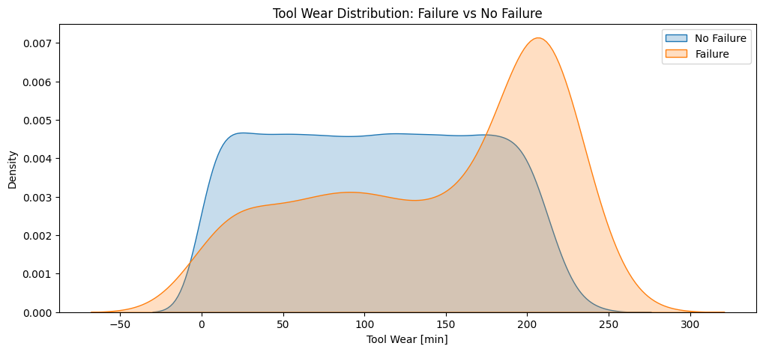
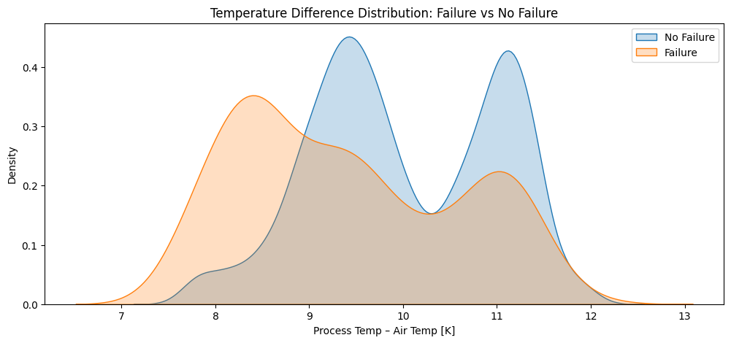
Key Factors Influencing Machine Failure
Machines are much more likely to fail when tools are heavily worn.
Even if everything else looks normal, old or worn tools alone can cause breakdowns.
The temperature difference shows how well the machine is cooling itself.
When this difference becomes small, it means heat is not escaping properly, increasing risk.
The highest failure risk occurs when worn tools and poor cooling happen together.

Slide 5
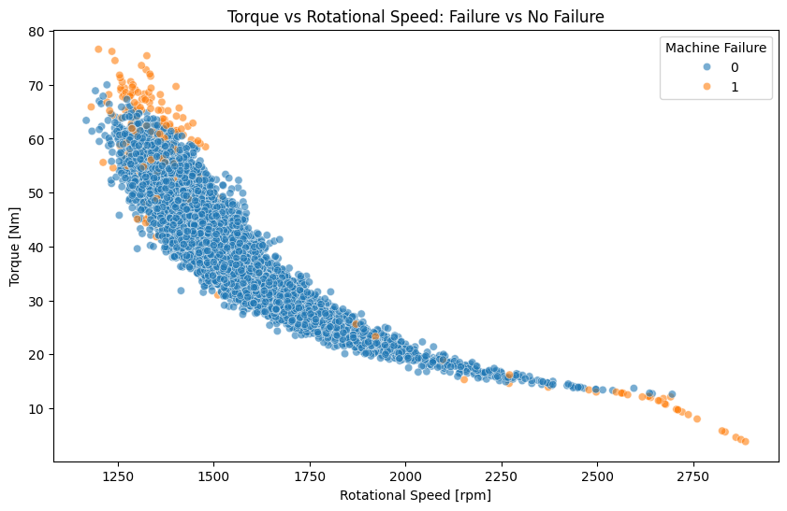
Mechanical Stress: Torque vs Rotational Speed
Machines operate safely within a normal balance of speed and load.
Failures mainly occur when machines are pushed too hard or operated inefficiently.
Very high load at low speed or very high speed with low load puts extra strain on components.
These extreme conditions accelerate wear and increase breakdown risk.
Failures are not random — they happen when machines operate outside safe limits.

Slide 6

“Analysis shows that machines usually fail for clear reasons — worn tools, poor cooling, or extreme operating conditions. By monitoring these factors and acting early, most failures can be avoided.”

Slide 7
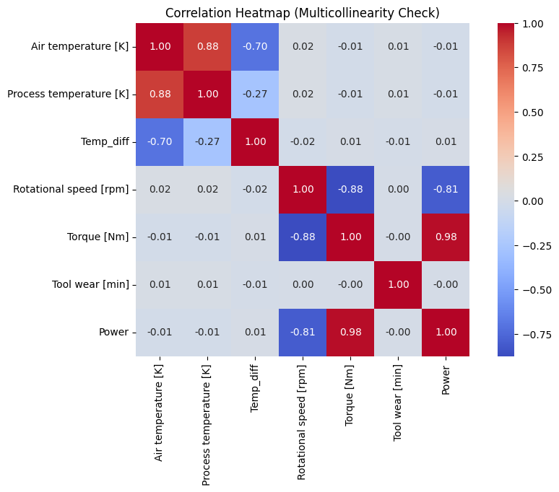
Statistical Analysis
“We carefully analyzed the data statistically to ensure that features used in modeling are meaningful and independent. This prevents misleading results, reduces model complexity, and ensures that our machine learning predictions are reliable and interpretable.”

Slide 8
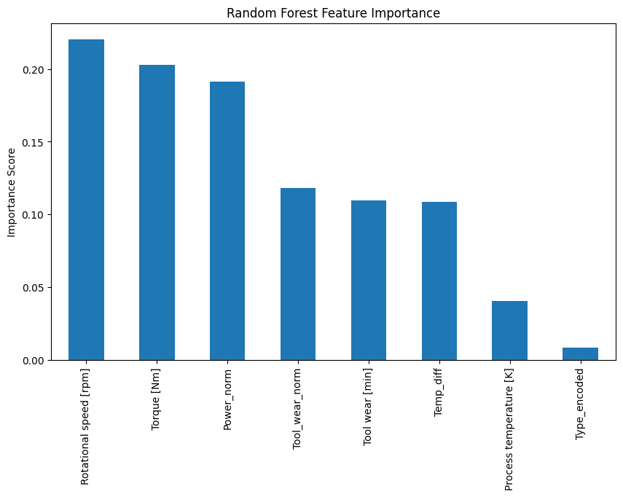
Predictive Modeling Approach
Model: Random Forest, handles non-linear relationships, robust to extra/missing columns
Feature Importance:
Rotational Speed, Torque, Tool wear, Power most important
Model Testing:
Accuracy ≈ 99.8%, ROC-AUC ≈ 0.9987
Confusion matrix shows almost all failures correctly predicted
Robust to new unseen data with extra columns
“Our model accurately predicts machine failures and is robust, so it can be deployed on live sensor data without breaking.”

Slide 9

Key Insights & Recommendations
Machine failures are primarily driven by:
High tool wear
Reduced cooling efficiency (low ΔT)
Extreme mechanical load (Torque × Speed extremes)
Recommended Actions:
Monitor tool wear and replace tools before end-of-life
Track thermal efficiency (ΔT) to prevent overheating
Limit operations at extreme torque-speed combinations
Use ML predictions to plan proactive maintenance
Combine thermal, mechanical, and tool wear indicators for early warning
“By focusing on these actionable insights, operations teams can reduce unexpected downtime, optimize maintenance schedules, and extend machine life.”

